Slide 1

Representing & Interpreting Data
COMMON CORE STANDARDS:
CCSS.HSS.ID.A.1 Represent data with plots on the real number line (dot plots, histograms, and box plots).
CCSS.HSS.ID.A.3 Interpret differences in shape, center, and spread in the context of the data sets, accounting for possible effects of extreme data points (outliers).
Created by: Math Byrd

Slide 2

DOT PLOT

Slide 3
Graphic display of data using dots
The data values are on the horizontal axis
The frequency of each data is represented by dots
Ex: A survey for “How many green shirts do you own?” had these results:
5, 3, 3, 0, 6, 2, 1, 4, 3, 7, 2, 4, 5, 4, 2, 5, 1, 6, 0
DOT PLOT
Graphic display of data using dots
The data values are on the horizontal axis
The frequency of each data is represented by dots
Ex: A survey for “How many green shirts do you own?” had these results:
5, 3, 3, 0, 6, 2, 1, 4, 3, 7, 2, 4, 5, 4, 2, 5, 1, 6, 0

Slide 4
Graphic display of data using dots
The data values are on the horizontal axis
The frequency of each data is represented by dots
Ex: A survey for “How many green shirts do you own?” had these results:
5, 3, 3, 0, 6, 2, 1, 4, 3, 7, 2, 4, 5, 4, 2, 5, 1, 6, 0
DOT PLOT
The modal value, or the number that appears most often in a set, is easily determined when examining a dot plot. What is the modal value, also known as the mode, for the previous example?

Slide 5
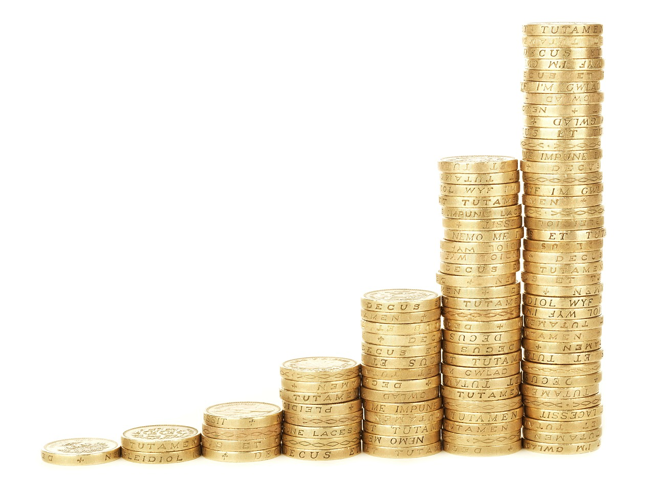
HISTOGRAM

Slide 6
HISTOGRAM
Graphic display of data using bars
The data values are grouped in number ranges, or class intervals, on the horizontal axis
The frequency of each data is on the vertical axis (height of bar)
Ex: A survey for the heights (in inches) of students in had these results:
51, 53, 68, 74, 66, 54, 55, 57, 72, 56, 59, 60, 61,63

Slide 7
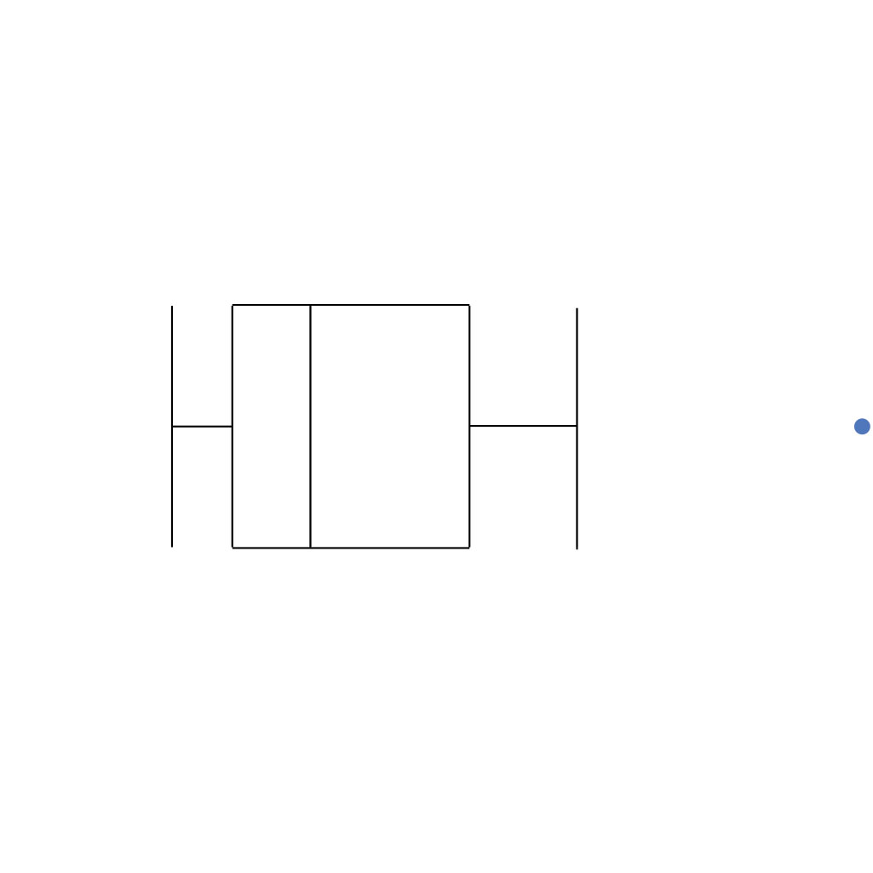
BOX PLOT

Slide 8
BOX PLOT
Find the 5 number summary of the data set: min., Q1, median, Q3, max.
2) Create a horizontal or vertical number line, make sure to use a scale that includes the numbers from your 5 number summary
3) Use the 5 numbers to create a box plot.
Ex: A survey for the average miles per gallon(mpg) of each car in a parking lot had these results: 29, 22, 13, 28, 24, 32, 25, 28, 27, 22, 30

Slide 9
BOX PLOT
The range, the difference between the maximum and the minimum values, is easily determined by examining a box plot. What is the range for the previous example?
The interquartile range, the difference between the 3rd quartile and the 1st quartile, is also easily determined by examining a box plot. What is the interquartile range in the previous example?

Slide 10

Distribution of Data
The distribution of data shows how the data is arranged. We can discuss distribution in 3 ways:
Center
Spread (variation)
Shape

Slide 11

Distribution of Data
Which measures of center and spread should
I use to describe data?
Is the distribution SYMMETRIC
(left side looks like right side)?
YES NO
Use the mean to discuss the center
and use the mean absolute deviation to discuss spread.
Use the median to discuss the center
and use the interquartile range to discuss the spread.

Slide 12
Distribution of Data
Normal/ Bell Shape Distribution,
Symmetric, More Spread

Slide 13
Distribution of Data
Unimodal, Symmetric,
Less Spread, mean≈median

Slide 14
Distribution of Data
U-Shape Distribution,
Symmetric, Bimodal

Slide 15
Distribution of Data
Asymmetric, Gap, Outlier

Slide 16
Distribution of Data
Skewed Right, Positive Skew, mean>median

Slide 17
Distribution of Data
Skewed Left, Negative Skew, median>mean

Slide 18
Distribution of Data
Uniform

Slide 19
Summary: Pick one!
-How do I summarize, represent, and interpret data?
-When describing sets of data, what factors are important to consider as far as which statistical calculations to use?
-What clues will give me an idea which graph will best represent my data?
-Why should I be concerned with interpreting data in the real world?

Slide 20
© Math Byrd 2017
All rights reserved. Purchase of this product provides one (1) purchaser the rights for solely personal classroom use. No part of this publication may be reproduced, distributed, or transmitted without the written consent of the author. Posting any part of this publication on the Internet in any form, including classroom and/or personal websites, social media, or network drives is strictly prohibited and in violation of the Digital Millennium Copyright Act (DCMA). To share this resource with colleagues, or use within a department, grade level, school, or district, additional licenses may be purchased through the Teachers Pay Teachers website: www.teacherspayteachers.com/store/math-byrd or via inquiry to mathbyrd@gmail.com

Slide 21


Dear Fellow Educator,
Thank you for supporting my product! I sincerely appreciate your business and hope that your students find this resource effective and engaging. All of my products are created with a passion!
I hope to read your thoughts under the comments & rating section of my TPT store, where you can find other Common Core aligned resources for Math, Algebra - Calculus.
With gratitude,
Jennifer Byrd
P.S. Please only share with colleagues by directing them to my TPT site:
www.teacherspayteachers.com/store/math-byrd
It’s about supporting teachers ☺

